Slide 1
PetroAustralis Petrophysics for the Pina Field (Cuba) Bottoms Up Analysis – Status Update
April 2022

Slide 2
Disclaimer
ERC Equipoise Ltd (“ERCE”) has made every effort to ensure that the interpretations, conclusions and recommendations set out in this presentation are accurate and reliable in accordance with good industry practice. ERCE does not, however, guarantee the correctness of any such interpretations and shall not be liable or responsible for any loss, costs, damages or expenses incurred or sustained by anyone resulting from any interpretation or recommendation made by any of its officers, agents or employees.
This presentation is produced solely for the benefit of and on the instructions of ERCE’s client to whom it is presented, and not for the benefit of any third party. Any third party to whom the client discloses or makes available this presentation shall not be entitled to rely on it or any part of it.
All estimates of reserves and resources in this presentation are provisional and subject to change. The client agrees to ensure that any publication or use of this presentation which makes reference to ERCE shall be published or quoted in its entirety and the client shall not publish or use extracts of this presentation or any edited or amended version of this presentation, without the prior written consent of ERCE.
In the case that any part of this presentation is delivered in digital format, ERCE does not accept any responsibility for edits carried out by the client or any third party or otherwise after such material has been sent by ERCE to the client.
ERCE has used standard petroleum evaluation techniques in the preparation of this report. These techniques combine geophysical and geological knowledge with assessments of porosity and permeability distributions, fluid characteristics and reservoir pressure. There is uncertainty in the measurement and interpretation of basic data. ERCE has estimated the degree of this uncertainty and determined the range of petroleum initially in place and recoverable hydrocarbons. Our methodology adheres to the guidelines of the SPE PRMS, unless specifically instructed to do otherwise. The accuracy of estimates of volumes of oil and gas and production forecasts is a function of the quality and quantity of available data and of engineering interpretation and judgment. While estimates of Reserves and production forecasts, Contingent Resources and Prospective Resources presented herein are considered reasonable, these estimates should be accepted with the understanding that reservoir performance subsequent to the date of the estimate may justify revision, either upward or downward. In the estimation of future cash flows, ERCE has relied upon oil prices and contract terms assumed and provided by the client, which may not reflect future signed contract values. There is no guarantee that actual economic parameters will match the assumed values. The net present value (NPV) calculations presented in this report simply represent discounted future cash flow values. Though NPVs form an integral part of the fair market value estimations, without consideration for other economic criteria they are not to be construed as ERCE’s opinion of fair market value.

Slide 3
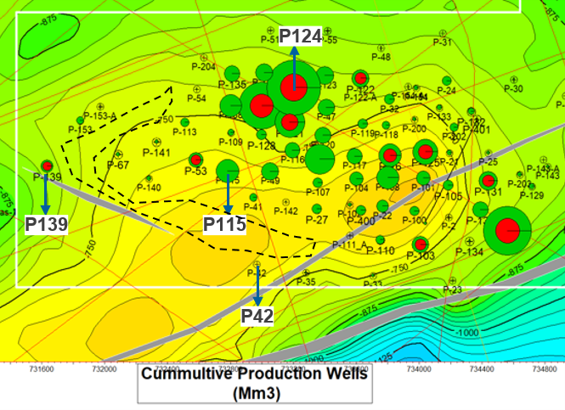
Petrophysical Interpretation
A quantitative petrophysical interpretation was performed on 82 wells in the Pina Field. The wells are being interpreted using a “bottom-ups approach” as part of Phase 2
The “tuff” formation was the formation of interest; secondary intervals include the “effusives” and “volcanics”.
Log quality was poor with many washouts; log suites were based on old-style “Russian logs”.
The irregular borehole has impact most of the logs, including the neutron and gamma ray
Infill location
Phase 1
ERCE has independently interpreted Volume of Shale (VSH), Total Porosity (PHIT) and Total Water Saturation (SWT) curves on 4 wells (P-42, P-115, P-124, P-139).
VSH is interpreted from RESDEEP, PHIn is interpreted from N (not hydrocarbon and invasion corrected) using the “high-low” method where high and low porosity points are calibrated to end-points from core (26 points) provided by the operator. SWT is interpreted using the modified Simandoux or Archie method; both results appear similar. ERCE has assumed a salinity value of ~90,000 ppm NaCl equivalent (provided by the client) with a=1, m=2 and n=2; electrical properties are based on analogue data.
Finally, Volume of Clay (VCL; the assumption being that VCL = 0.6*VSH), Effective Porosity (PHIE) and Effective Water Saturation (SWE) are interpreted.
ERCE has used cut-offs of VCL ≤ 0.4, PHIE ≥ 0.07 and SWE ≤ 0.60.

Slide 4
Discussion with Jerry (24 Mar 2022)
No diagnostic tool/ data set available to differentiate dual porosity system.
Based on the current data set, we observe a dual porosity system but this is from thin section, Pc measurements and core images
Image logs show fractures which we infer to play an important role in this field
Fractures are highly variable in both lateral and horizontal directions
ERCE agrees with this assessment, based on observations of core images
The decision to frack wells is (partly) based on downhole gauge measurements; >30 atm wells are candidates for fracturing (there are operational considerations which still play a part in the decision-making process)
Original reservoir pressure is ~100 atm; with depletion, modern pressure measurements are needed to map out the field wide pressure variation and determine methods for production optimization.
Fracking has shown evidence of penetration into zones that are at pressures as high as 90 atm i.e. virgin undrained rock
Tuffs are highly water wet
ERCE has attempted to diagnose intervals which are good fracture candidate wells using porosity- saturation
ERCE has also attempted to understand production behavior based on perf length.

Slide 5
Lithofacies Summary
Component | General Description
Clay | Greenish grey and beige, very incoherent, bentoitic, little calcareous.
Shale | Grey, dark beige and greenish grey, calcareous, silty and sometimes sandy components, the layers are thin, open and sealed fractures cemented by calcite.
Sandstone | Brown to sandy tuff, white and greenish grey, calcareous cement is mixed with volcanic glass and transitions to tuff, fragments of quartz, feldspars, green and grey andesites, reddish brown basalt and olive chlorite.
Clay | Grey and olive green, very unconsolidated, little bentonite, limited volcanic glass.
Conglomerate | Tuffs with fragments of green and grey andesites, cream color, greenish yellow and light green with marked fluid texture, some fragments stained with light reddish oil, slightly oxidized. Tuffs are broken and lithoclast crystals, also inlays of black and fibrous obsidian as well as reddish black biotite crystals, little consolidated by pelitization, rare fragments of white quartz diorite, mottled in dark green, very hard
Tuff | Sandy, grey, greenish and white, coarse-grained, lithic and crystalline texture, consolidated, some slightly pelitized, lithoclasts of green and dark grey andesites, quartz, broken plagioclase, chlorite, pyrite, amphibole and little biotite crystals
Effusive, Basalt | Composed primarily of basalts and andesites and identified by a significant increase in log resistivity
 | Basalts are described as cataclastic, their structure defined by severe mechanical stress under dynamic metamorphism. Strong chloritization is present
 | Plagioclase, calcite and zeolite filled fractures
 | Andesite composition, dark color, course grained, silicates (quartz, plagioclase, feldspars, muscovite)
Marly sandstones, polymitic sandstones,conglomerates, limestone and clay
Tuff conglomerate
Andesitic tuffs interbed with clays, carbonates, sandstones
Coarse andesitic tuffs
Basalt andesitic rock interspersed with tuffs, clays, carbonates, sandstones

Slide 6
Core Analysis

Slide 7
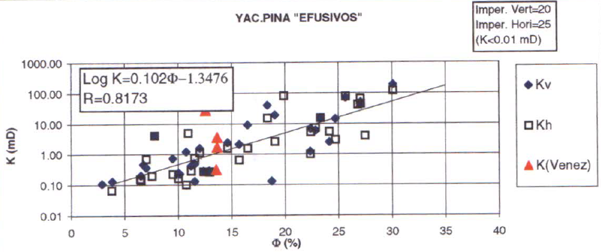
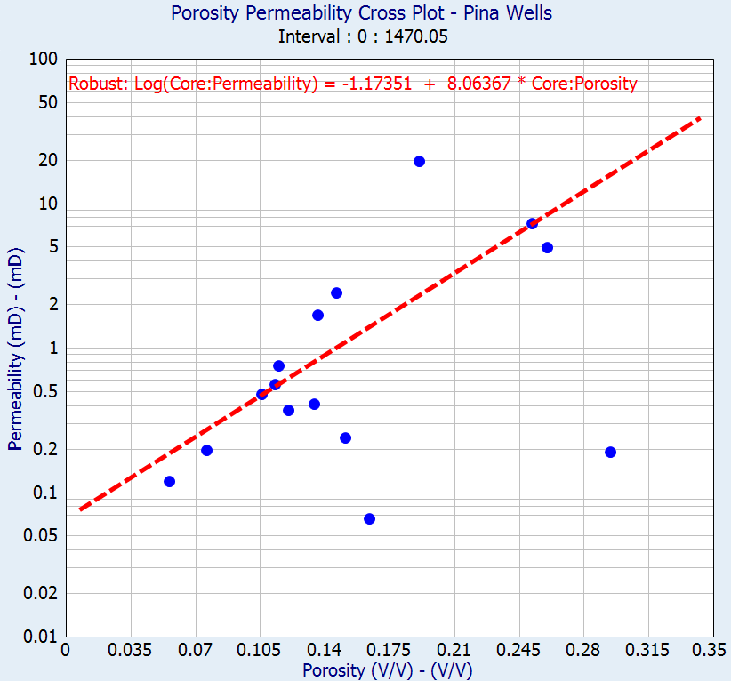
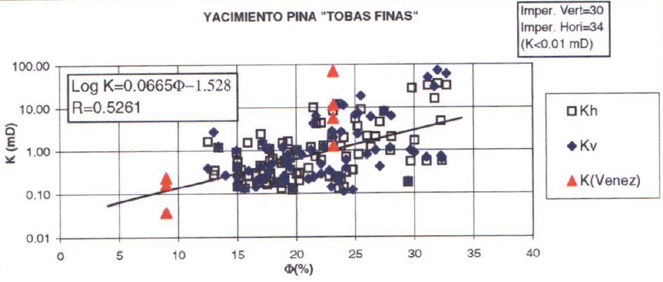
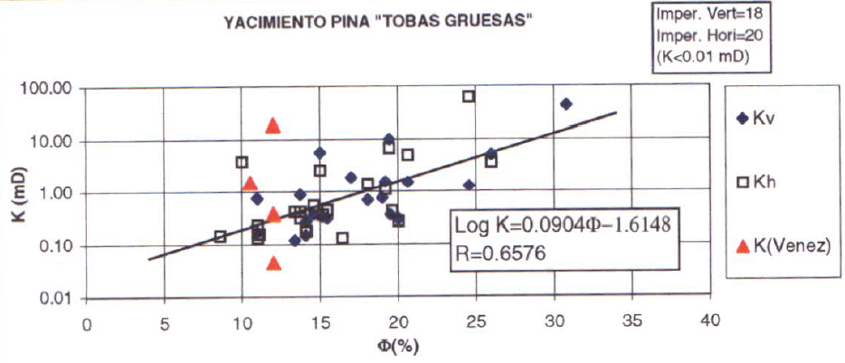
Porosity-Permeabilty Trends
P99
P90
P10
P1
Porosity-Permeability Cross-plot for all available core data in Pina (26 plugs)
(Phase 1 work) The regression trend line is drawn through most of the points, and ignores the point that have high porosity but low permeability
Core - P1: 0.02 & P99: 0.35
(On the left, Phase 2 data), core porosities between 4 – 35%. Permeability from 0.1-100 mD
Source: Caracterización del reservorio yac pina 1998

Slide 8
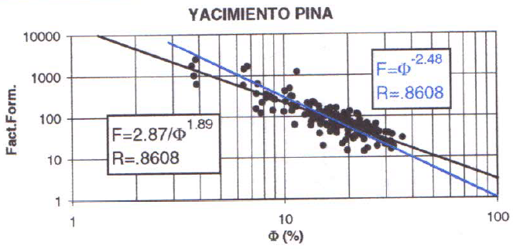
Electrical Properties – Cementation Exponent
Fine, Coarse grained tuffs and effusives
Factor between 1.89 and 2.48, ERCE has used a factor of 2.00

Slide 9
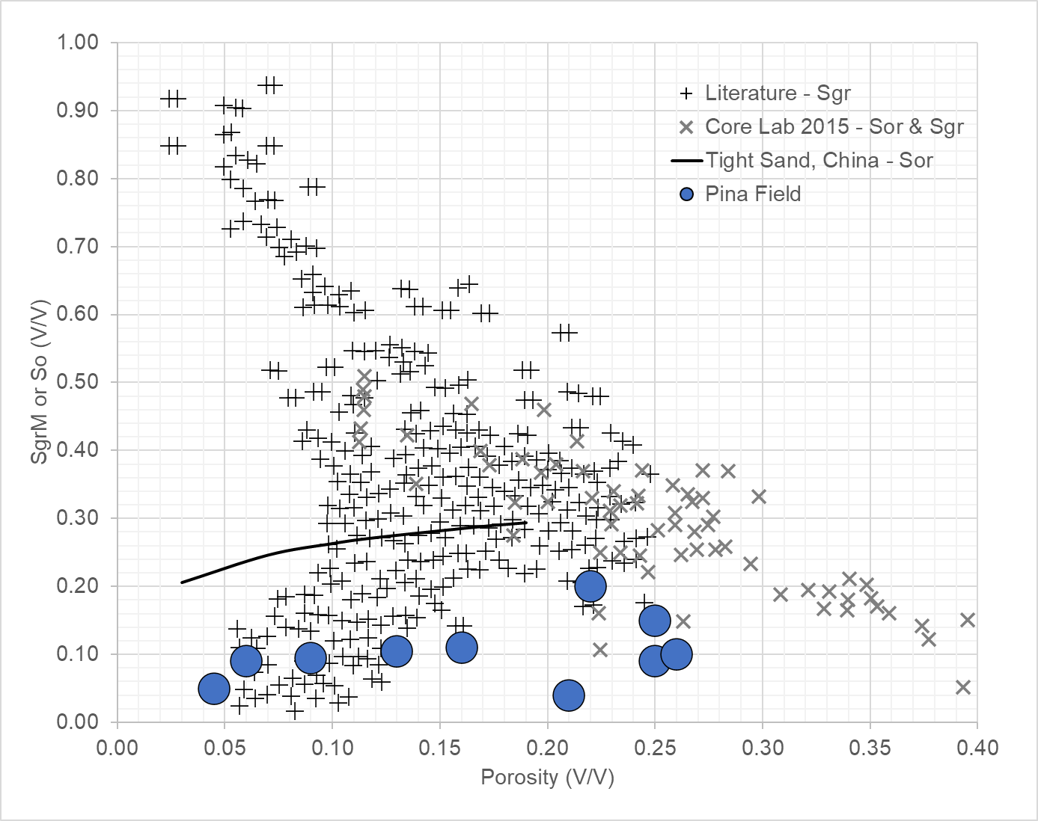
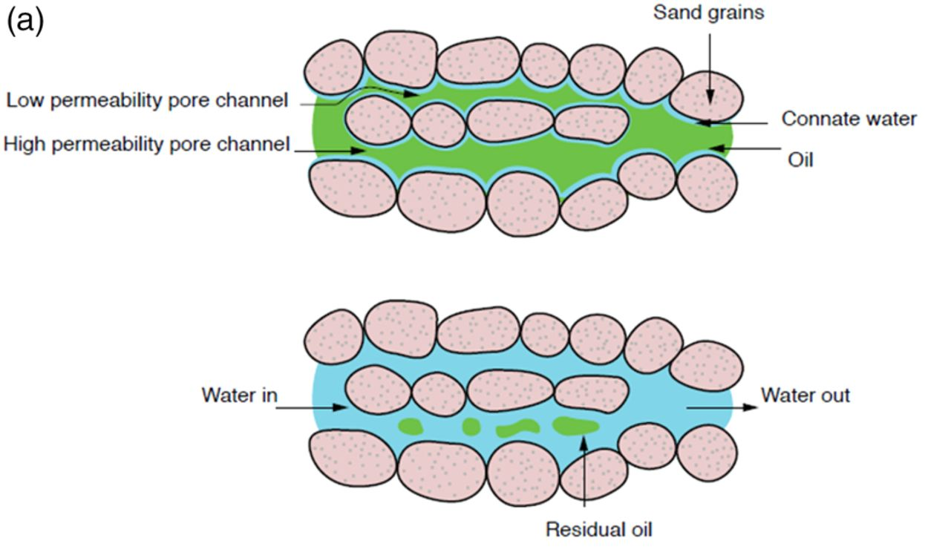
Residual Phase Saturation
ERCE has plotted a graph of residual phase saturation vs porosity from an analogue database (the database unfortunately does not differentiate between oil or gas residual phase) and compared it against the Pina field.
Also included is the residual phase saturation associated with core plugs measurements made in a “Chinese Tight Gas Sand” field in the Ordos Basin
ERCE observes that the residual phase in the Pina Field is low; the measurements seem to cluster close to measurements made by core lab in 2015, in highly clay-rich, shaly sands. A low residual likely means good sweep efficiency, with very little remaining oil in the pore space
Quantifying remaining oil saturation using time-lapse seismic amplitude changes at fluid contacts, Petroleum Geoscience
SPE 84038

Slide 10
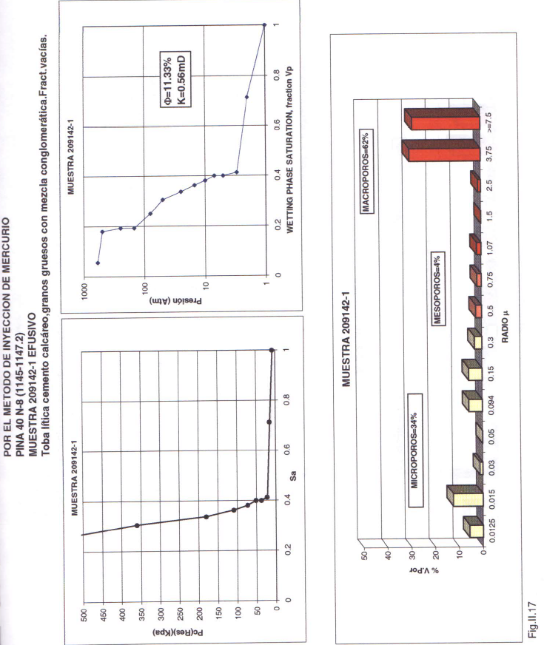
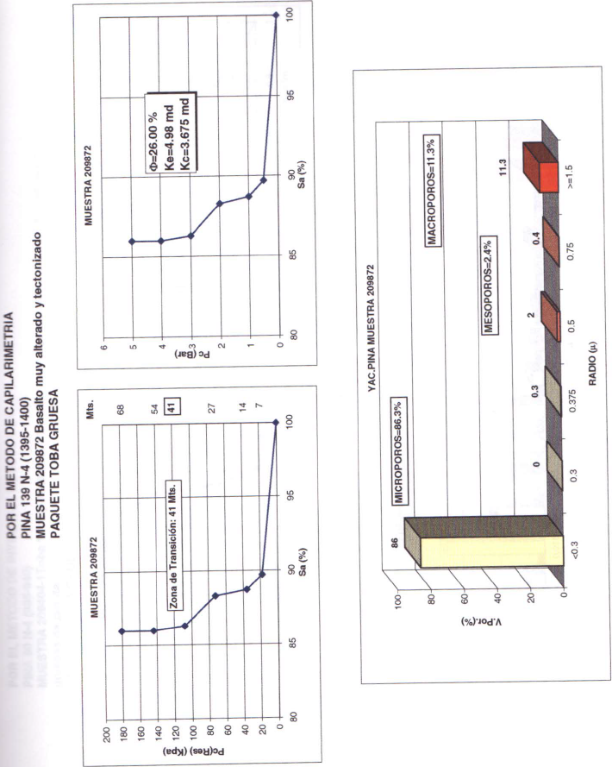
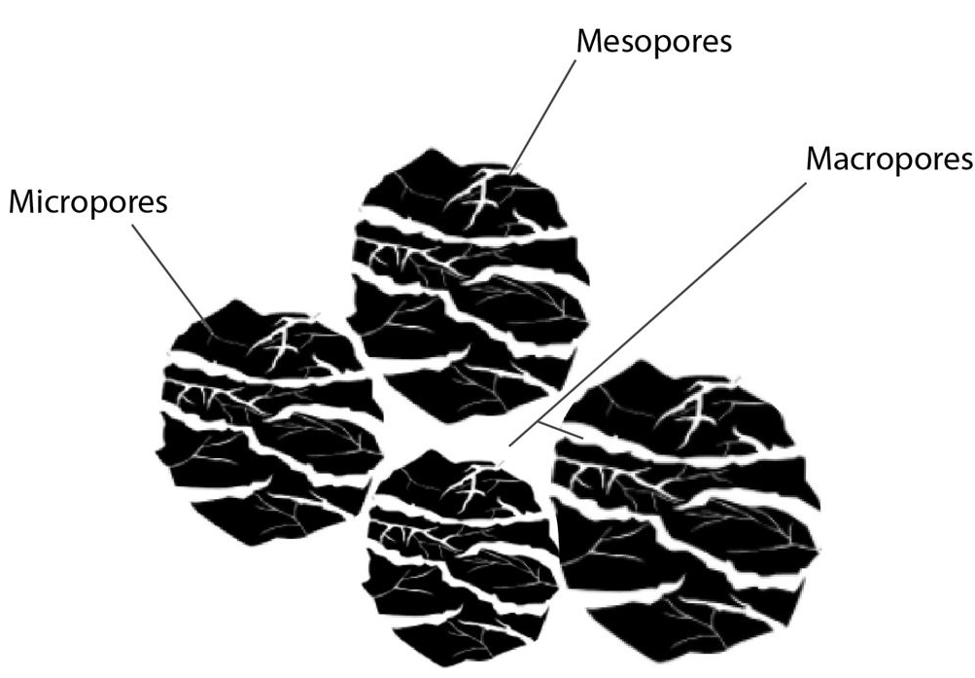
Capillary Pressure Behavior
23 Pc samples - 7 samples porous-plate (PP), 10 samples centrifuge (Cent - fluid type reverse engineered to be oil-water), 6 samples mercury intrusion (MICP)
All Pc samples used to constrain height above free water level (HAFWL); Pc is also useful to show the pore size distribution.
PI 40 N8 (1146 mMD) MICP Effusivo
PI 139 N4 (1398 mMD) PP Coarse Grained Tuffs
It is observed that while most of the pore space is made up of macropores and micropores with mesopores acting to bridge the 2 pore sizes
Macropores (≥ 1.5 μm) – Porosity between grains (intergranular), fracture width > 50 μm
Mesoporosity (≥ 0.03 - 1.5 μm) – Porosity associated with silts or very fine grain, within particle itself, fractures width 5-50 μm
Micropores (≤ 0.03 μm) – Porosity associated with clays or microfractures, fractures width < 5 μm

Slide 11
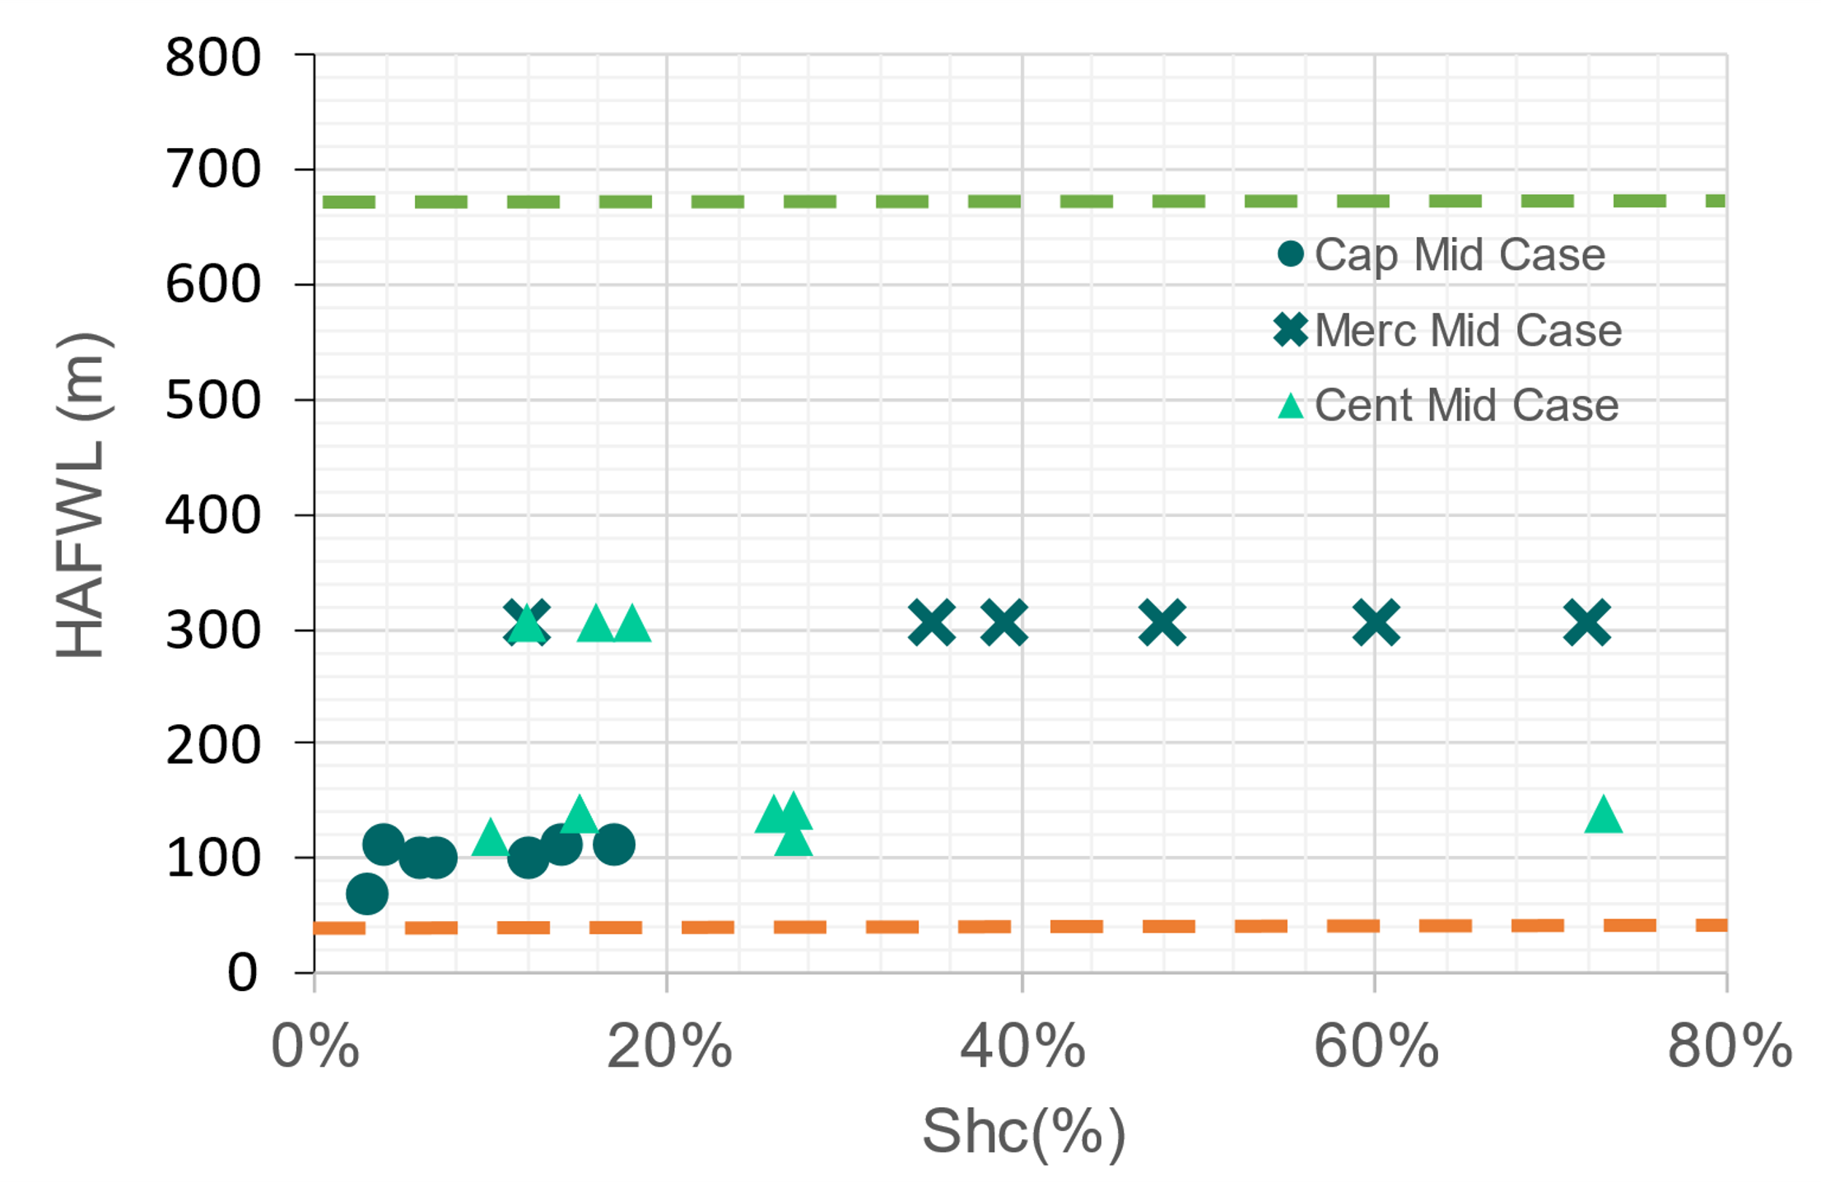
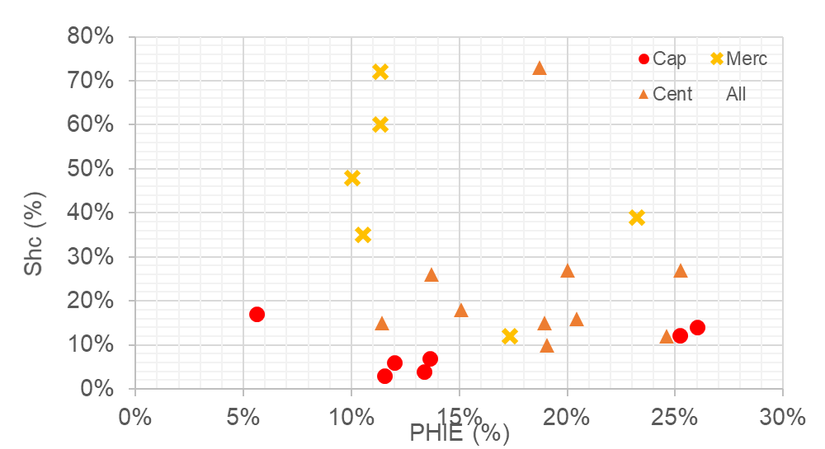
Capillary Pressure Behavior
Samples using Mercury Intrusion Capillary Porosimetry method read higher saturations than by centrifugation and capillary → not fully saturated in the other methods
High Case Max
Low Case Max
Low, mid, high determined by wide range of oil gradient, water gradient:
 | Air-Water | Oil-Water | Hg-air
σcosθres | 46 | 28
σcosθlab | 72 | 48 | 371.5
Water Gradient (psi/m) | 1.420 | 1.45 | 1.48
Oil Gradient (psi/m) | 1.083 | 1.214 | 1.312
API | 45 |  | 15

Slide 12
Thin Sections

Slide 13
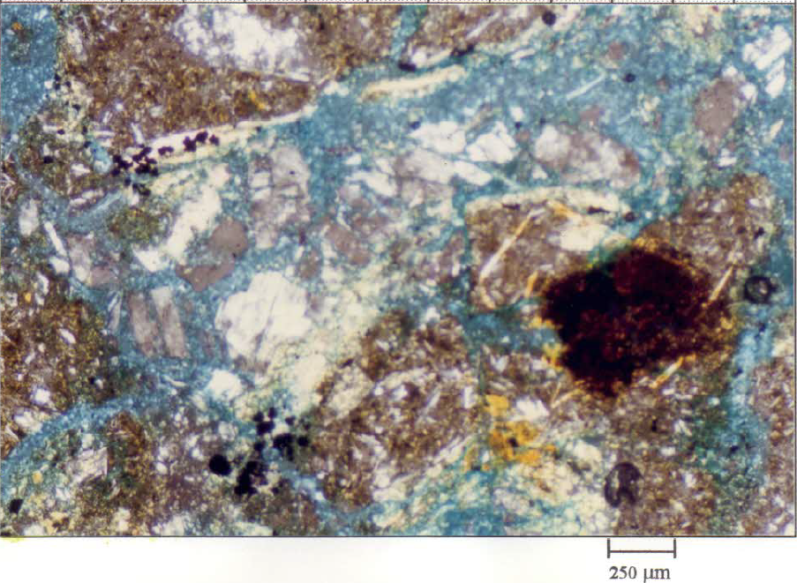
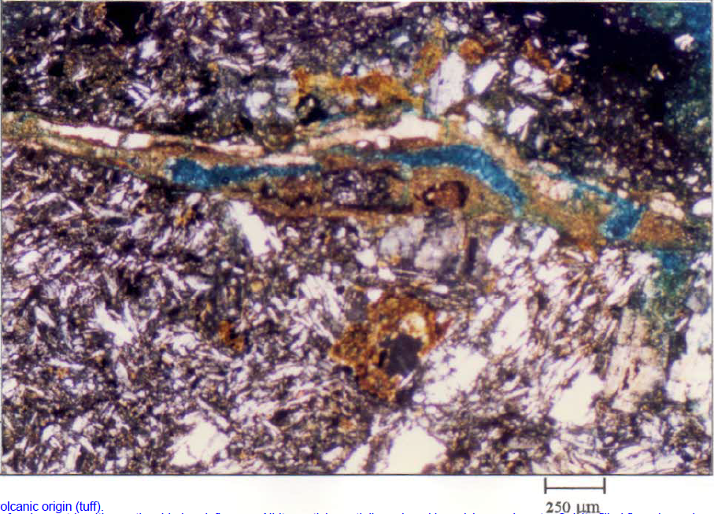
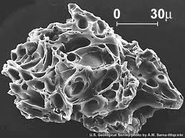
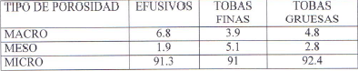
Top Tuff @ 1240 mTVD in Brujo-2
Micropores in connection
No. 8 (1268 m)
No. 3 (1360 m)
Calcite-filled flow channel; some “epoxy” present within fracture
No. 8 (1268 m)
Macropore with clay present; pore appears isolated
Sample with characteristic needle fragments of volcanic origin (tuff).
Tuff is complicated because it is hard to define/ separate macro/meso/micro due to surface roughness
SEM image of a single particle from the eruption of Mt. St. Helens

Slide 14
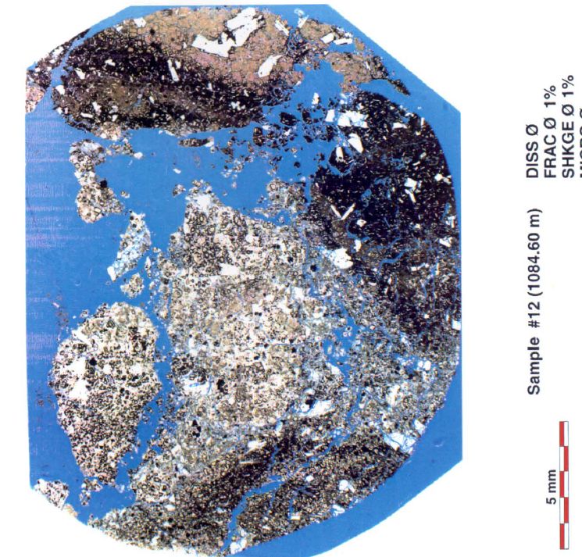
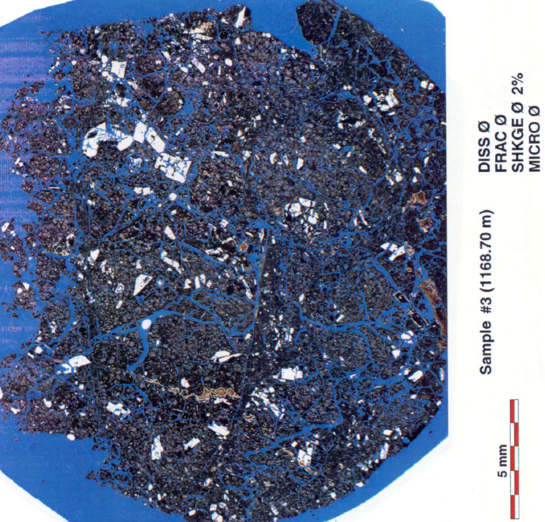
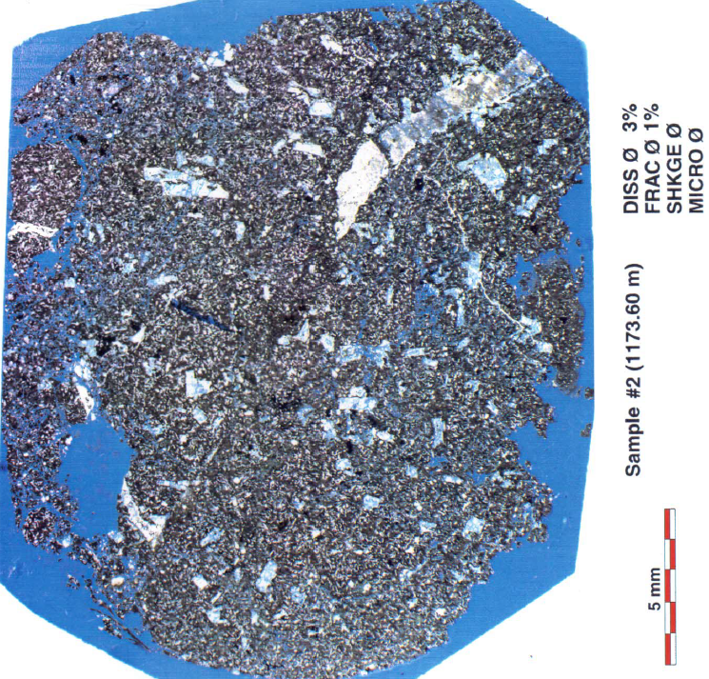
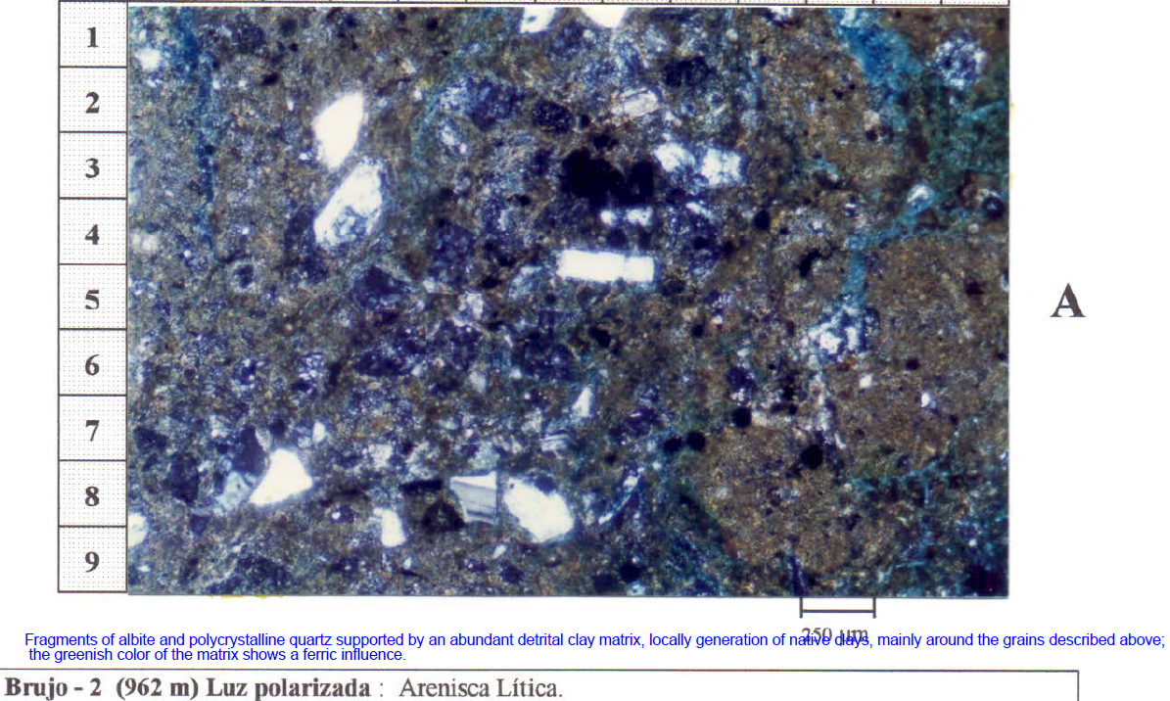
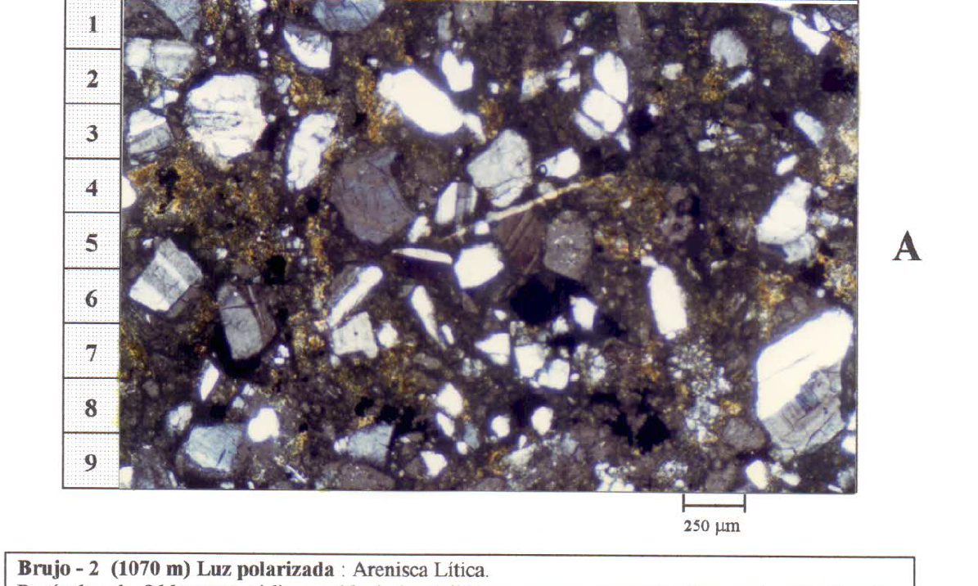
Top Volcanics @ 1048 mTVD in PI-154
Fragments of albite and polycrystalline quartz
Samples 12 – 20 (980 – 1080 m) very broken on the thin sections, possibly very brittle
Abundant detrital clay matrix
PI-154
Connected Microporosity
Isolated? Or lost material?
No. 27 (962 m)
No. 20 (1070 m)
From Brujo-2: possible representatives of grains closer up

Slide 15
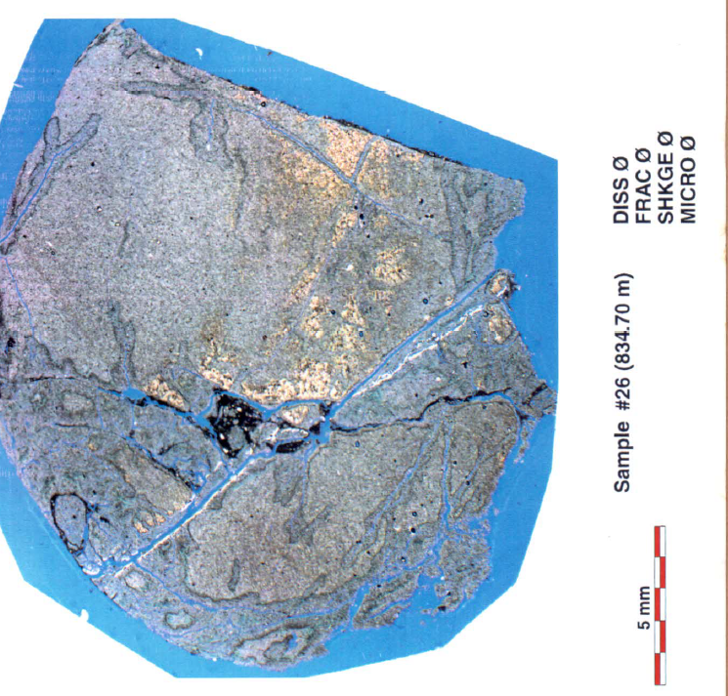
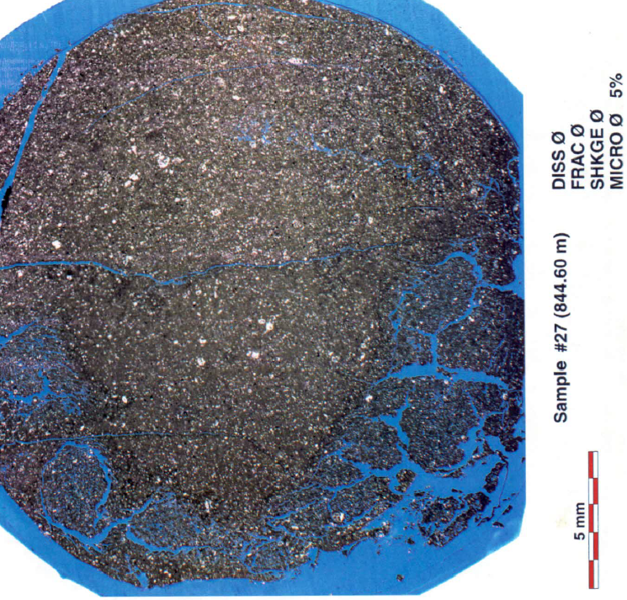
Above Top Efusivos @ 1048 mTVD in PI-154
Fine grained plagioclase (67%)
Carbonates (77%)
Above the Volcanics, fine grained plagioclase and carbonates

Slide 16
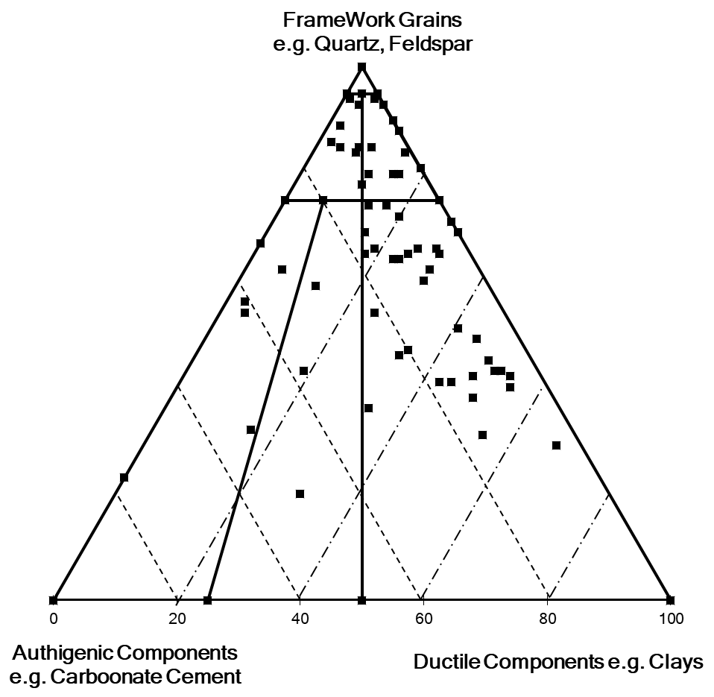
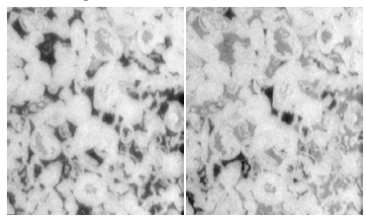
XRD Minerology
Majority of the tuffs are quartz and feldspar (framework) with clay as the next major component
Average Framework Grains ~61.6%
Average Ductile Components ~24.5%
Average Authigenic Components ~13.9%
Supports the assumption that fracking is affecting the ductile components; the cements are mostly within healed fractures
Hydrocarbon fluid would be contained in the macroporosity supported by the framework grains
Depending on column height, and given the extensive proportion of microporosity, hydrocarbon can potentially fill the micropore space as well
Isolated macropore that is surrounded by microporosity
Illustration of the fluid filled pore space within a carbonate microporous sample
Invaded macropore that is surrounded by microporosity
Spontaneous Imbibition – Sor ~ 33%
Forced Imbibition – Sor ~ 18%

Slide 17
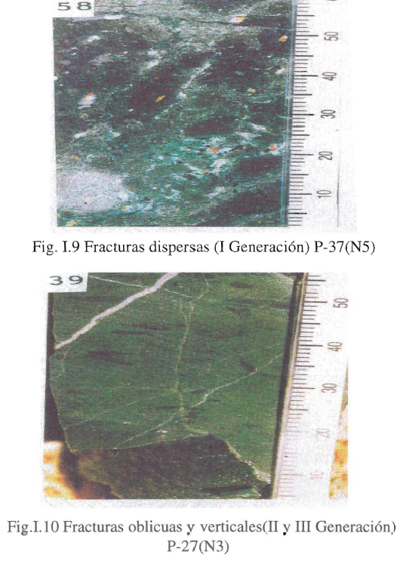
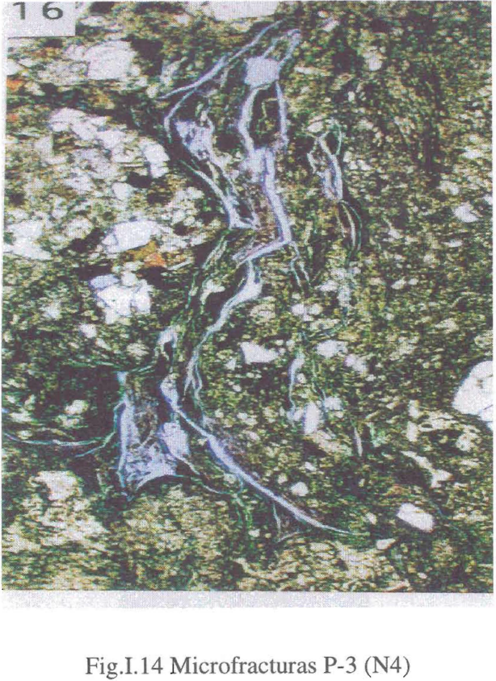
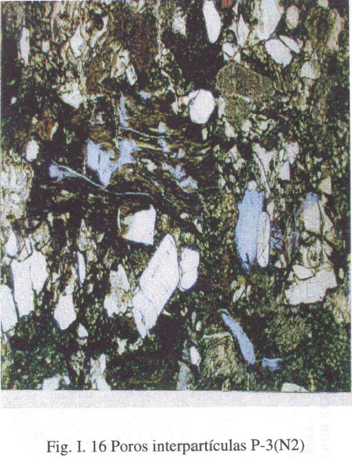
Microfractures and Interparticle Porosity
There is fracture anisotropy here and both filled and unfilled fractures are observable
In combination with capillary pressure data, fractures do not contribute to volumes but are extremely important for connectivity (most volume is held in interparticle, macroporosity and microporosity)

Slide 18
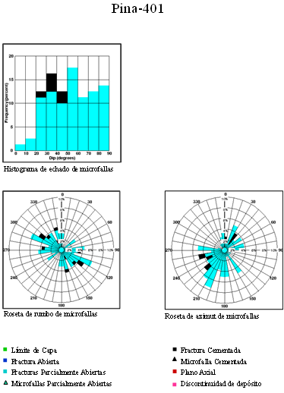
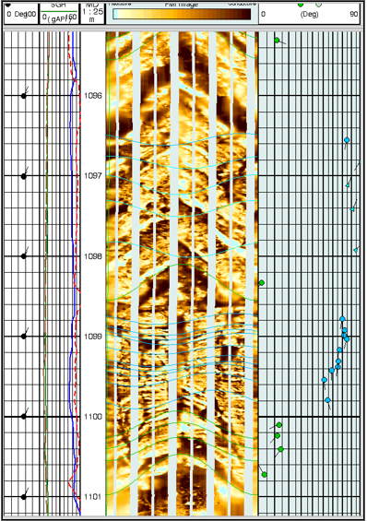
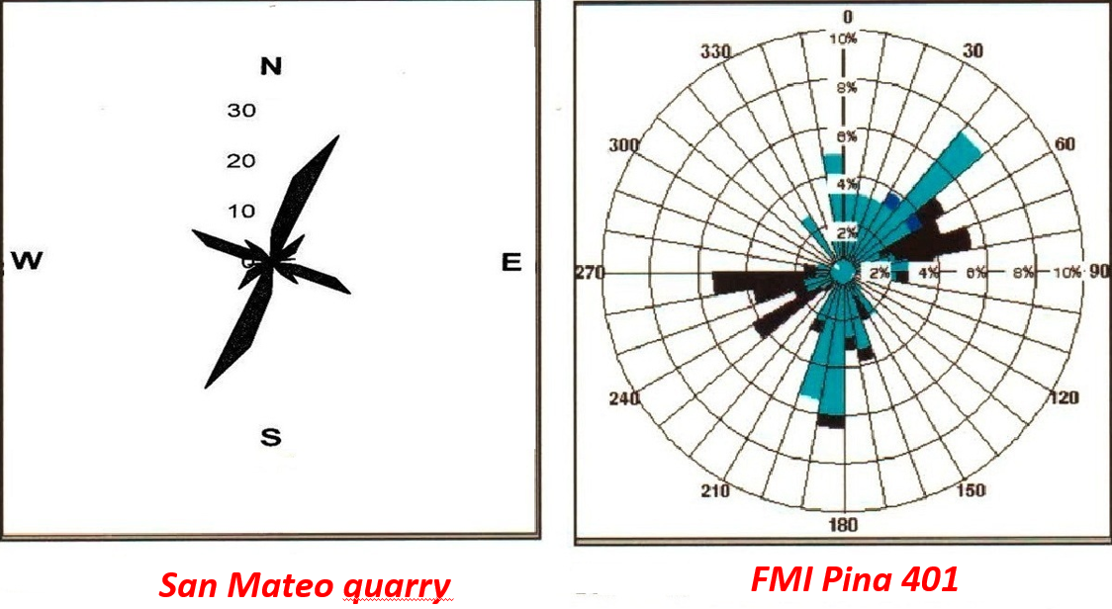
FMI
Source: Caracterización del reservorio yac pina 1998.pdf
Induced Fractures (fractures are filled with conductive drilling fluid)
High resistive features; sinusoid – cement filled fractures
Notes:
The formations above and below sinusoid are not very different which indicates no displacement of the rock, therefore it is not a fault instead it is a fracture.

Slide 19
Log Interpretation

Slide 20
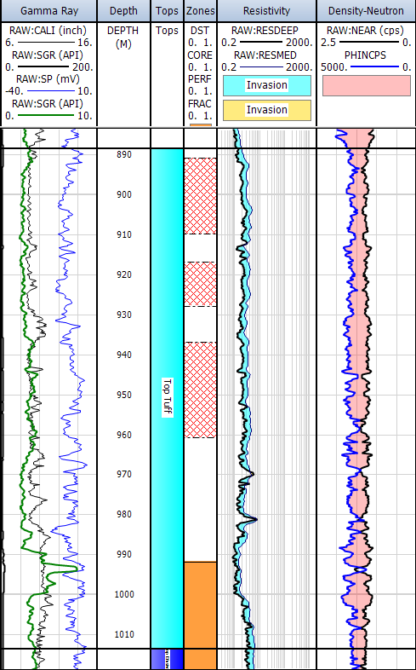
Phase 2
PI-119: Np~93.8 Mstb
Petrophysical study of 82 wells. Integration with core.
Main challenges
Logs are of various vintages and are inconsistent in terms of naming and type of logs
Many of the logs have no dynamic range, making interpretation very difficult (e.g. NEAR, GR)
Numerous logs are missing, some are truncated, and this increases the uncertainty (GR, CALI, RESDEEP, FAR, PHIN)
There is drift in the SP making it difficult to define a baseline; additionally, since this is tuffaceous formation, it is hard to define a sand-shale boundary. SP deflections are difficult to define because of macro-meso-micro porosity
There are some unusual curve names and unclear units that necessitate the use of assumptions e.g. M → PHIN
There was differing vintages of neutron logs
FAR, NEAR, PHIN, NPHI
Resistivity widely swings from <10 ohmm to 100 ohmm, yet oil was produced in said wells
ERCE has developed 2 models based on the available data – no “one size fits” all solution
For wells that are missing PHIN, ERCE uses the near and far detector to evaluate the porosity and saturation using min-max scaling
For wells that have PHIN, ERCE scales the count and than uses a similar min-max scaling approach
Ideally, if done properly, both will yield consistent results

Slide 21
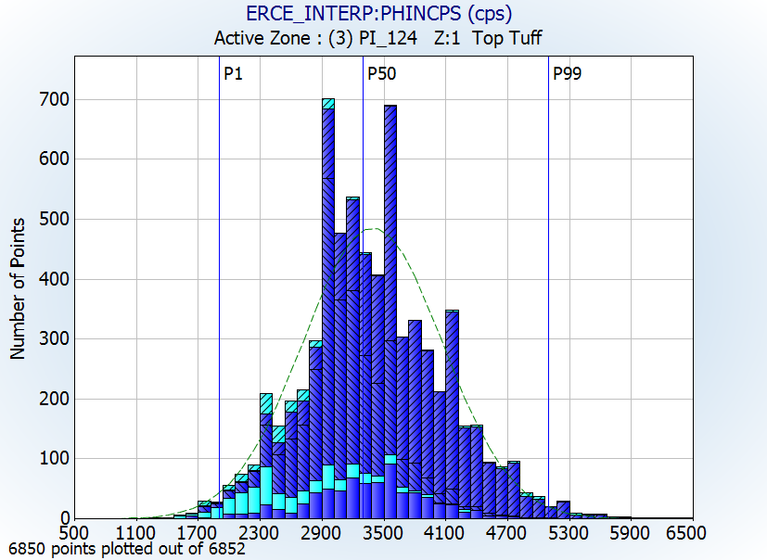
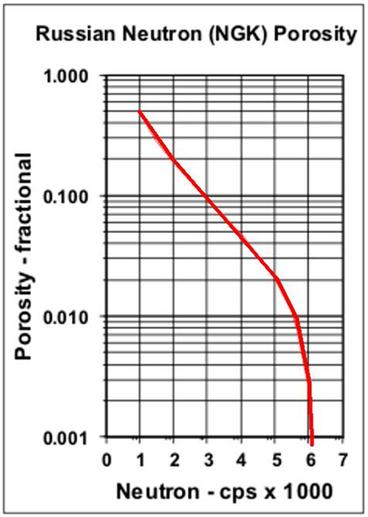
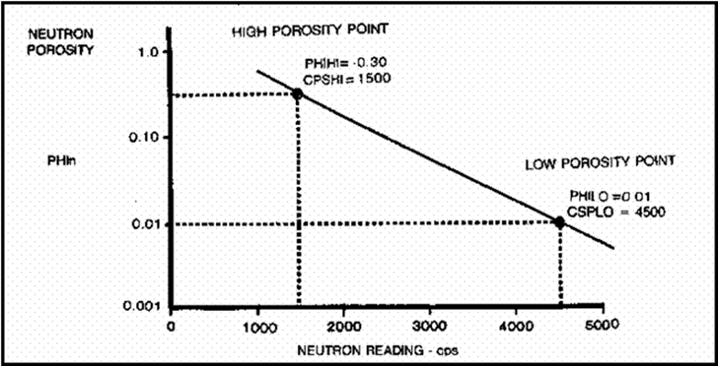
Methodology
Gamma Ray (GR)
VSH & VCL
Due to the lower dynamic range of GR, result is typical defaulted to VCL from RT in most instances
Deep Resistivity (RT)
SWT & SWE
Attempt to incorporate clay effects by considering Simandoux, otherwise Archie solution as default
NEAR
Counts*
PHIN⁺
FAR
Counts*
Rescale
*Count rate is inversely proportional to porosity.
+ While PHIN should be from 0-1, some of the provided curves have PHIN > 1

Slide 22
High-Low Porosity Calibration
P99
P90
P10
P1
PHIN Histogram distribution
Porosity-Permeability Cross-plot for all available core data in Pina (26 plugs)
The P1-P99 values of the PHIN histogram are calibrated to the P1-P99 core values
PHIN is scaled by multiplying with a constant of 10000 to increase the dynamic range of the data.
PHIN - P1: 1800 & P99: 5100
The regression trend line is drawn through most of the points, and ignores the point that have high porosity but low permeability
Core - P1: 0.02 & P99: 0.35

Slide 23
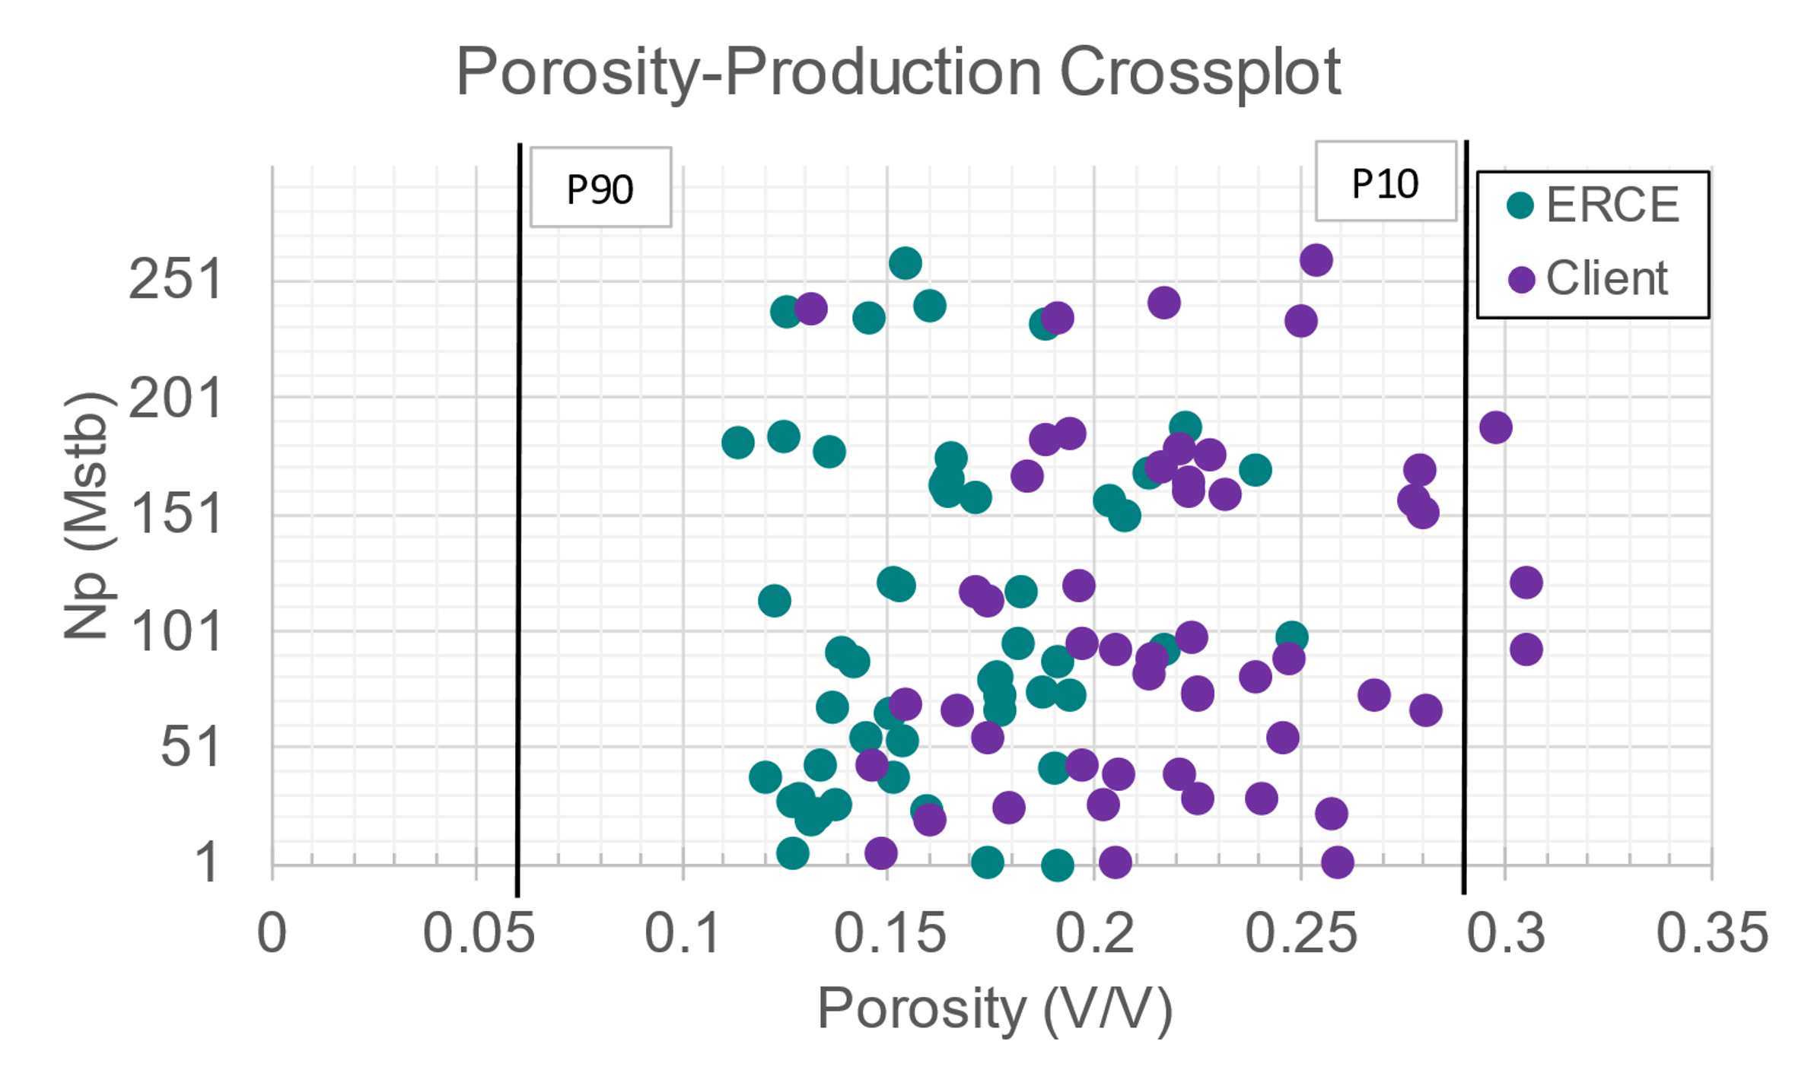
All Porosity Production Crossplot
Fractured and Candidate Fracture wells omitted
P10 and P90 porosity of previous poro-perm study plotted at 0.06 and 0.29
ERCE range narrower, between 0.12 and 0.25
Source: Caracterización del reservorio yac pina 1998

Slide 24
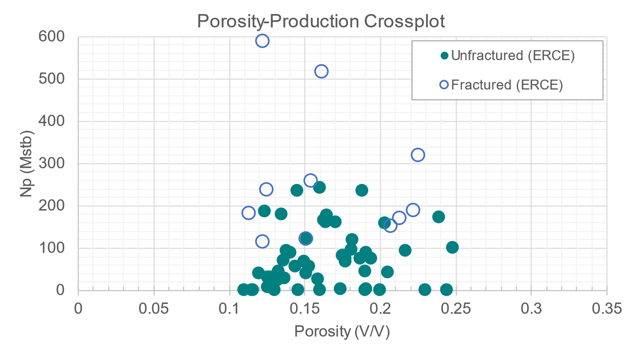
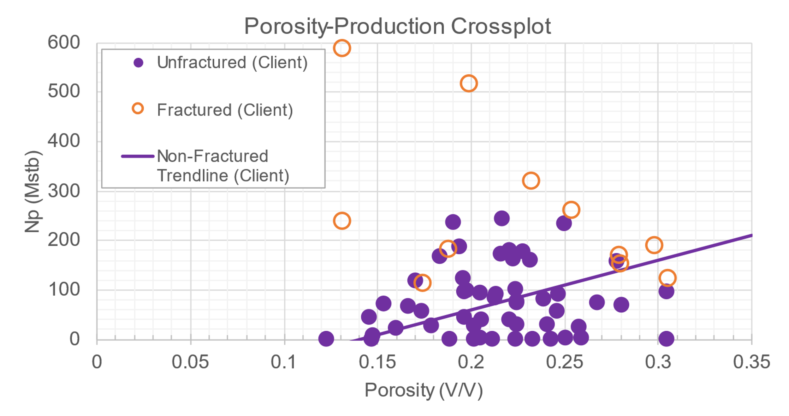
ERCE Porosity Production Crossplot: Fracture Effect
Listed Fracture Candidate | ERCE Pay PHIE | Np Mstb | ERCE Pay Sh
PI_026 | 0.188 | 233 | 0.59
PI_130 | 0.171 | 159 | 0.56
PI_128 | 0.181 | 96 | 0.76
PI_141 | 0.137 | 27 | 0.65
PI_135 | 0.164 | 167 | 0.67
PI_028 | 0.144 | 55 | 0.72
PI_105 | 0.248 | 99 | 0.70
Unfractured wells do not show increase in performance with better porosity
Fractured wells perform better than unfractured wells
Lower porosity rocks seem to perform better after fracturing

Slide 25
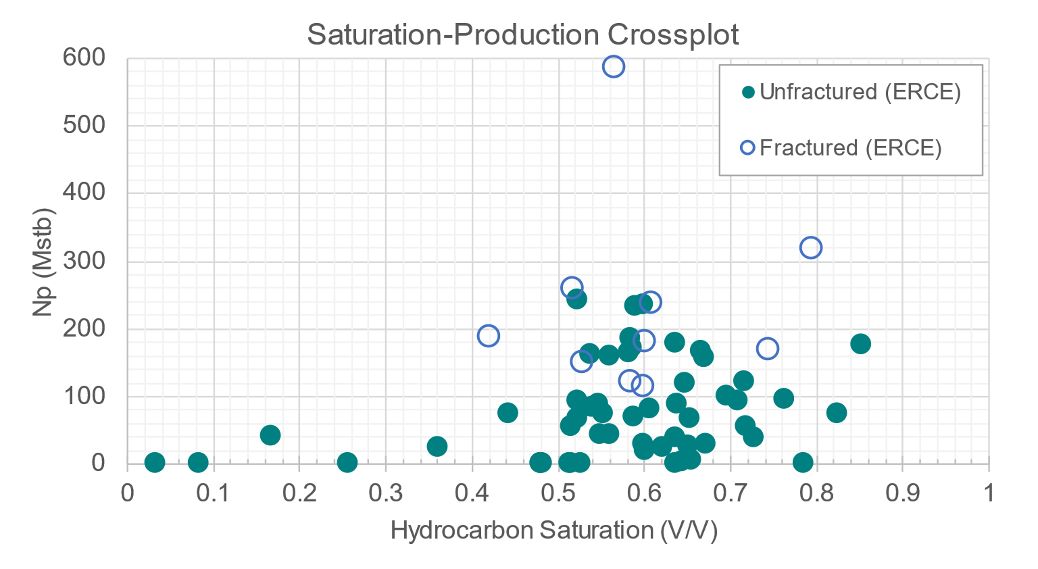
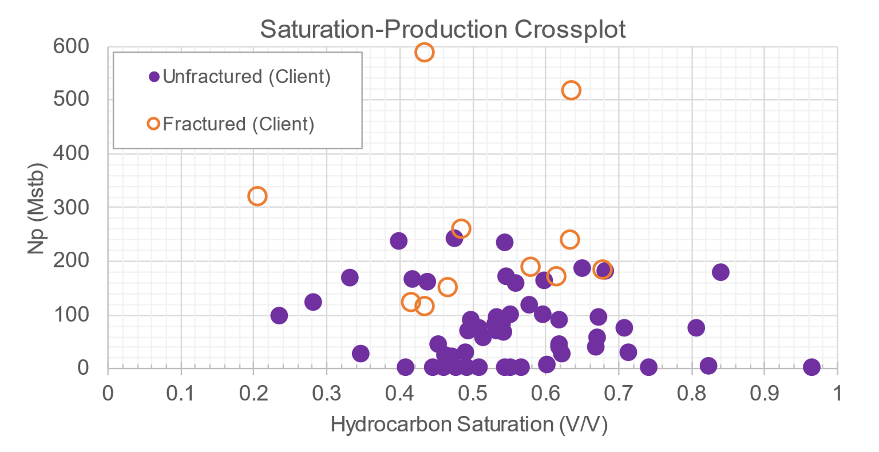
ERCE Saturation Production Crossplot: Fracture Effect
Fractured wells perform better than unfractured wells, regardless of saturation
Saturations > 50% are zones that can contribute significantly to produced volumes

Slide 26
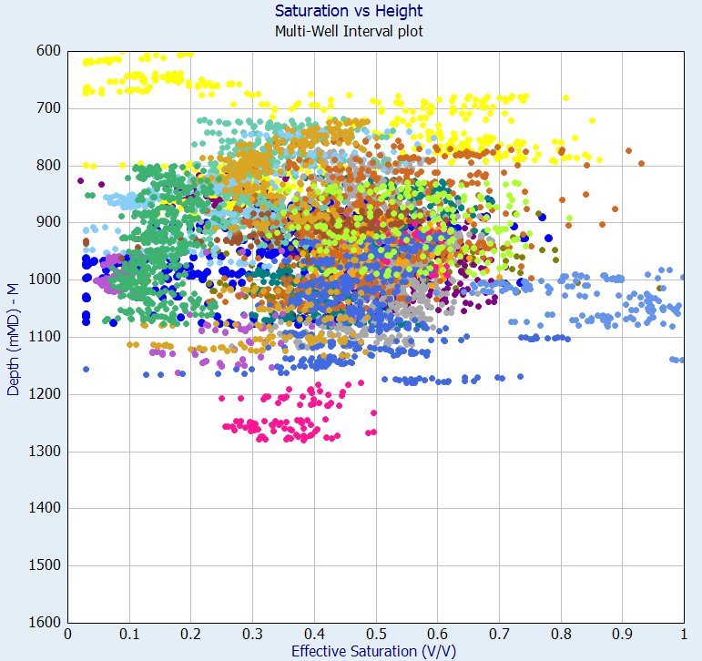
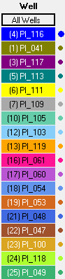
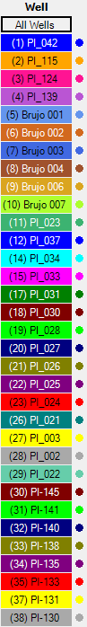
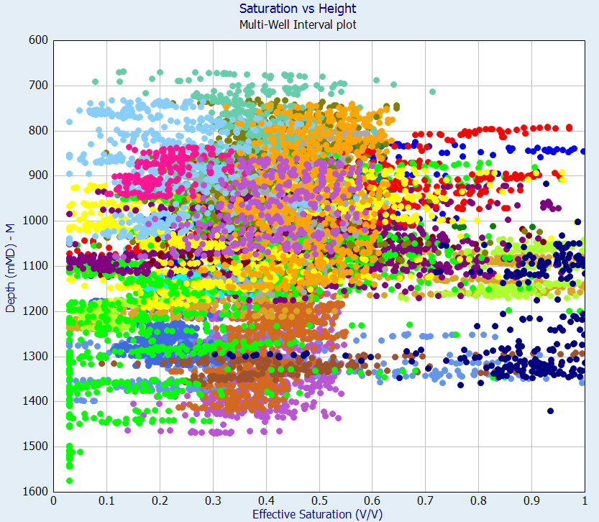
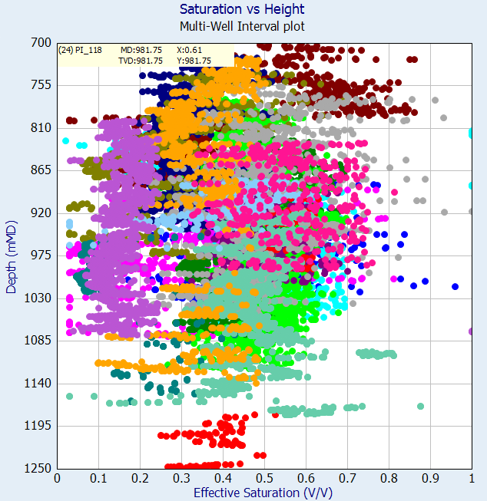
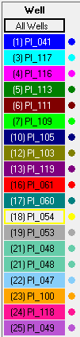
Saturation – Height Cross-plot
Consistent water saturation distribution at ~40% (P50)
Low side and High side vary ±10-15%
Some variation with height; correlation is weak.
Wells Pina-41 to -119
(excluding Pina-42 and Pina-115)

Slide 27
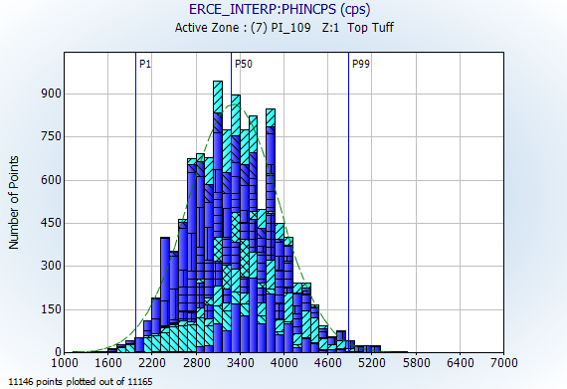
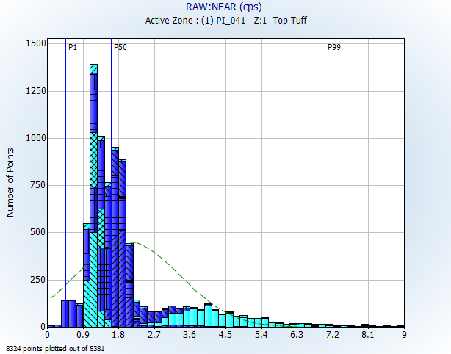
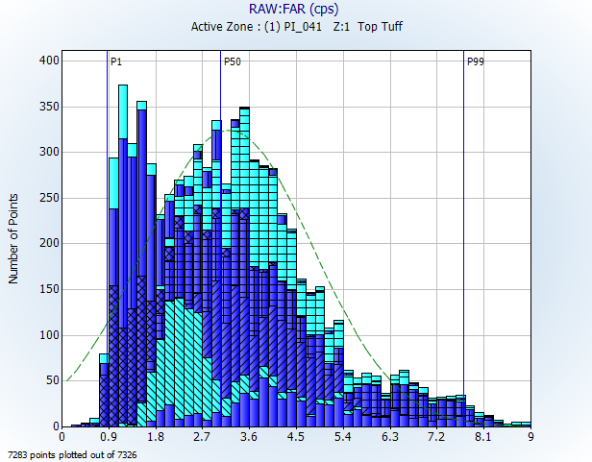



PHINCPS, NEAR and FAR Distributions
PHINCPS
NEAR
FAR
PI-054,
PI-048 and PI-047
Wells Pina-41 to -119
(excluding Pina-42 and Pina-115)
PI-053
Wells Pina-2 to -151, Pina-42, Pina-115 & Brujo-2, -3 & -4
(excluding Pina-41 to Pina-119)
Normalised between 1000 - 6000
Large range in the wells
PI_053 centered around 4.2 cps instead of 1.5 cps
Large range in the wells
PI-054, PI-048 and PI-047 centered around 1.2 cps instead of 3.6 cps for the P50 of the other wells

Slide 28


Client and ERCE Porosity and Saturation Bubble Plots
No observable correlation between porosity and saturation distribution at a field-wide level; differences appear to be randomly distributed
After calibration, ERCE notes that ~50% of the wells of the wells with a material difference in porosity (± 4 p.u.) to client, with 16 wells being ± 8 p.u. or more than the client (~22%)
ERCE porosities are generally lower (63 wells) but within core limited boundaries
Porosity
ERCE
Saturation
ERCE

Slide 29


Porosity-Production Bubble Plots
No observable correlation between porosity and production distribution at a field-wide level
The three largest producers have been fractured; original porosities at fractured wells varies between 10 – 25%
Porosity variation does not seem to impact frac efficacy
Well sorted systems with little to no clay are less ideal candidates for fracking

Slide 30


Saturation-Production Bubble Plots
No observable correlation between saturation and production distribution at a field-wide level
The three largest producers have been fractured; original saturations at fractured wells varies between 50 – 90%

Slide 31

CPI of PI-124 – High Oil Production + Fracture
RESMED > RESDEEP; is drilling mud fresher?
Low PHIN = Low PHIE
Cumulative oil production of 587 Mstb and 189 Mstb water as of 2021
Shown here is Top Tuff interval. There are further perforations in Andesite interval below

Slide 32

CPI of PI-115 – High Oil Production + No Fracture
Low PHIN = Low PHIE
Cumulative oil production of 241.7 Mstb and 53 Mstb water as of 2021
Massive gross thickness of 370 m (bottom half continued next page)

Slide 33

CPI of PI-115 – High Oil Production + No Fracture
Similar observations to previous plot, where low PHIN should give you a low PHIE and therefore a high SWE; the zones should be non-net

Slide 34


CPI of PI-111 – Low Oil Production + No Fracture
Cumulative oil production of 2.6 Mstb and 2.4 Mstb water as of 2021.
Top 300 m of Tuff interval unperforated. Log here shows bottom 100 m of the Tuff interval. Porosity interpreted by ERCE is lower than client. Unclear if high saturation is pre or post-production

Slide 35




Spread of Data
ERCE observes a log-normal distribution in net-pay
Porosity and saturation seen to be evenly distributed around the mean

Slide 36
CPI – Sums and Averages for Top Tuff
Sums and Averages for Low (<0.15), Mid (0.15<PHIE<0.2) and High (>0.2) porosity wells (every 3rd well shown)
Well | Top TVDSS (m) | Bottom TVDSS (m) | Gross TVDSS (m) | Net Pay (m) |  | Pay Porosity |  | Pay Sh |  | HCPT (m)
 |  |  |  | ERCE | Client | ERCE | Client | ERCE | Client | ERCE | Client
PI_061 | 900.0 | 1280.0 | 380.0 | 91.5 | 60.4 | 12% | 15% | 57% | 57% | 6.0 | 5.0
PI_140 | 850.9 | 1339.8 | 488.9 | 9.3 | 34.2 | 12% | 22% | 56% | 46% | 0.6 | 3.6
Brujo 001 | 1030.5 | 1400.0 | 369.5 | 105.4 | 324.7 | 14% | 15% | 73% | 67% | 11.1 | 33.1
PI_023 | 933.8 | 1102.5 | 166.3 | 78.3 | 28.8 | 11% | 12% | 67% | 55% | 5.8 | 1.9
PI_031 | 992.7 | 1178.8 | 186.1 | 40.3 | 13.8 | 15% | 24% | 49% | 51% | 2.9 | 1.7
PI_002 | 800.9 | 1176.2 | 367.3 | 239.3 | 76.8 | 14% | 15% | 60% | 54% | 19.4 | 6.3
PI_152 | 919.3 | 1042.5 | 123.3 | 45.8 | 6.0 | 12% | 17% | 60% | 44% | 3.3 | 0.5
PI_129 | 1001.2 | 1110.0 | 108.9 | 32.5 | 101.3 | 13% | 20% | 55% | 62% | 2.4 | 12.4
PI_122 | 933.1 | 1021.9 | 88.8 | 49.5 | 75.8 | 11% | 19% | 60% | 68% | 3.4 | 9.7
PHIE<0.15 | 720.1 | 1620.3 | 6409.6 | 130.7 | 111.1 | 14% | 18% | 66% | 62% | 11.7 | 12.6
Low
PI_041 | 735.1 | 1052.0 | 174.1 | 64.5 | 18.0 | 18% | 28% | 60% | 50% | 6.9 | 2.5
PI_111 | 580.0 | 888.0 | 308.0 | 203.4 | 251.1 | 17% | 21% | 73% | 83% | 25.9 | 42.5
PI_054 | 965.0 | 1160.6 | 195.7 | 0.3 | 7.3 | 19% | 26% | 40% | 48% | 0.0 | 0.9
PI_145 | 1028.1 | 1095.7 | 67.6 | 57.8 | 38.8 | 15% | 20% | 72% | 75% | 6.3 | 5.7
PI_128 | 731.2 | 1052.0 | 320.8 | 291.2 | 271.4 | 18% | 20% | 77% | 58% | 40.4 | 31.0
PI_042 | 824.0 | 996.0 | 172.0 | 8.8 | 10.3 | 19% | 19% | 45% | 45% | 0.7 | 0.9
Brujo 004 | 1289.5 | 1360.0 | 70.5 | 58.0 | 46.9 | 17% | 13% | 61% | 56% | 5.9 | 3.4
PI_026 | 730.7 | 1059.0 | 324.5 | 289.2 | 158.0 | 19% | 25% | 60% | 55% | 32.5 | 21.6
PI_003 | 920.7 | 1186.0 | 265.3 | 140.9 | 151.1 | 16% | 20% | 78% | 64% | 17.7 | 19.1
PI_153 | 881.1 | 1254.0 | 373.0 | 340.5 | 267.0 | 15% | 17% | 65% | 54% | 33.4 | 24.3
PI_203 | 904.4 | 1030.1 | 125.6 | 81.3 | 121.9 | 15% | 22% | 73% | 67% | 8.9 | 18.1
0.15<PHIE <0.2 | 580.0 | 1437.3 | 7595.6 | 164.1 | 141.8 | 17% | 22% | 64% | 62% | 17.7 | 19.5
Mid
PI_116 | 859.5 | 1078.6 | 219.1 | 159.8 | 64.2 | 20% | 28% | 69% | 56% | 22.3 | 10.0
PI_119 | 888.5 | 1013.7 | 125.3 | 118.0 | 112.0 | 22% | 31% | 53% | 53% | 13.5 | 18.2
PI_047 | 877.0 | 961.4 | 84.4 | 68.6 | 36.3 | 24% | 22% | 59% | 55% | 9.6 | 4.3
Brujo 006 | 1067.5 | 1239.8 | 172.4 | 102.0 | 122.5 | 20% | 20% | 76% | 68% | 15.6 | 16.7
0.2<PHIE | 718.3 | 1239.8 | 2216.4 | 129.4 | 85.9 | 22% | 26% | 63% | 57% | 18.3 | 12.8
High

Slide 37

Impact of Perforation Length on Production
Caveat: ERCE has noted that production is co-mingled with some contribution from effusives and volcanics in certain wells.
Based on the available data set, ERCE is unable to break out the production contribution from the non-Tuff intervals
The plot of perforation length vs Production assumes that only the Tuff are contributing.
Based on the plot, there is no correlation between cumulative production and perforation length

Slide 38
CPI – Sums and Averages for Perforated Zones
Sums and Averages for Low (<0.15), Mid (0.15<PHIE<0.2) and High (>0.2) porosity wells (every 3rd well shown)
Well | Top TVDSS (m) | Bottom TVDSS (m) | Gross TVDSS (m) | Net Pay (m) | Pay Porosity | Pay Sh | HCPT (m)
 |  |  |  | ERCE | ERCE | ERCE | ERCE
PI_109 | 771.3 | 1120.0 | 348.7 | 131.3 | 15% | 55% | 10.7
PI_100 | 720.1 | 1140.0 | 419.9 | 129.0 | 14% | 63% | 11.3
Brujo 001 | 1030.5 | 1400.0 | 369.5 | 16.9 | 14% | 65% | 1.5
PI_028 | 1000.7 | 1620.3 | 619.6 | 128.3 | 15% | 74% | 13.9
PI_148 | 1052.7 | 1201.6 | 149.0 | 68.8 | 13% | 68% | 6.0
PI_123 | 908.8 | 1024.6 | 115.8 | 33.2 | 13% | 62% | 2.7
PHIE<0.15 | 720.1 | 1620.3 | 3928.4 | 49.9 | 14% | 65% | 4.5
Low
PI_117 | 813.2 | 1056.4 | 243.3 | 69.0 | 16% | 60% | 6.7
PI_049 | 740.0 | 1078.0 | 278.1 | 86.5 | 16% | 85% | 11.5
Brujo 002 | 1143.8 | 1420.0 | 276.2 | 87.5 | 16% | 61% | 8.4
Brujo 007 | 1036.8 | 1240.0 | 203.2 | 47.1 | 15% | 73% | 5.2
PI_026 | 730.7 | 1059.0 | 324.5 | 80.5 | 18% | 57% | 8.0
PI_022 | 668.4 | 1000.0 | 331.6 | 92.0 | 17% | 63% | 10.0
PI_110 | 685.6 | 902.5 | 214.6 | 96.8 | 19% | 62% | 11.2
0.15<=PHIE <0.2 | 668.4 | 1437.3 | 5109.0 | 75.5 | 16% | 64% | 7.8
Mid
PI_116 | 859.5 | 1078.6 | 219.1 | 65.0 | 22% | 71% | 10.0
PI_103 | 739.0 | 1002.3 | 263.4 | 65.8 | 25% | 75% | 12.4
PI_047 | 877.0 | 961.4 | 84.4 | 23.8 | 23% | 59% | 3.2
PI_202 | 800.1 | 1164.3 | 364.1 | 20.4 | 21% | 61% | 2.7
0.2<=PHIE | 580.0 | 1239.8 | 2176.9 | 55.6 | 22% | 66% | 8.2
High

